Slide 1
Microprocessors
Lecture 1
Third Class

Slide 3
Outline
Overview of Intel Microprocessors
Discussion of History of Computers
Function of Microprocessor
Basic Information about Microprocessor
Memory and I/O Space
Buses

Slide 4
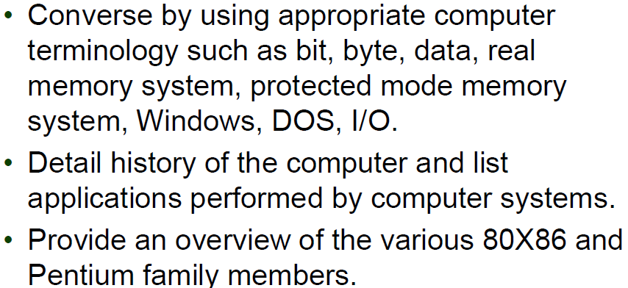
Objectives

Slide 5
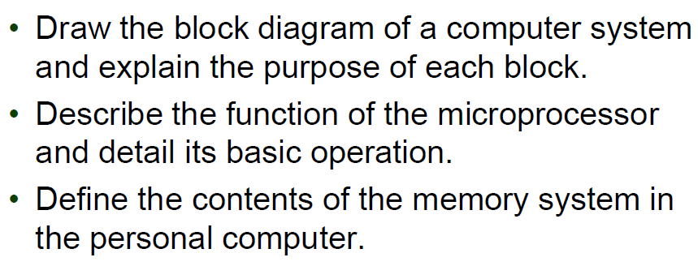
Objectives

Slide 6
Historical Background
Mechanical Age
Electromechanical Age
Electronic Age

Slide 7
Mechanical Age

Slide 8
Mechanical Age

Slide 9
Mechanical Age

Slide 10
Mechanical Age

Slide 11
Mechanical Age

Slide 12
Electromechanical Age

Slide 13
Electromechanical Age

Slide 14
Electromechanical Age

Slide 15
Electromechanical Age

Slide 16
Electromechanical Age

Slide 17
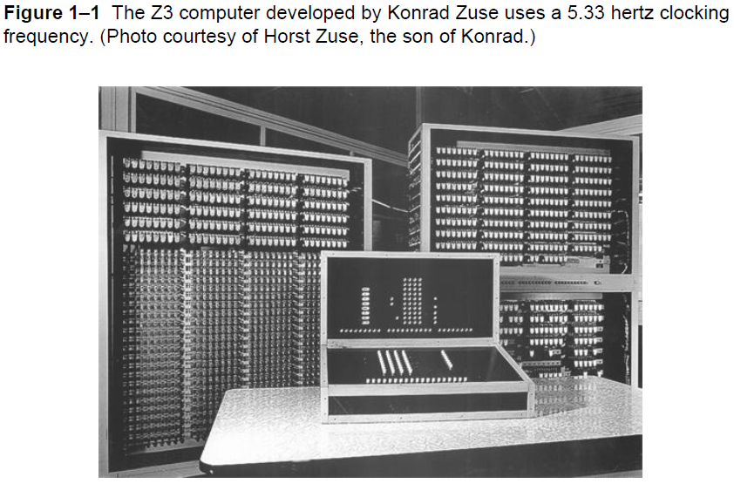
Electromechanical Age

Slide 18
Electromechanical Age

Slide 19
Electronic Age

Slide 20
Electronic Age

Slide 21
Electronic Age

Slide 22
Electronic Age

Slide 23
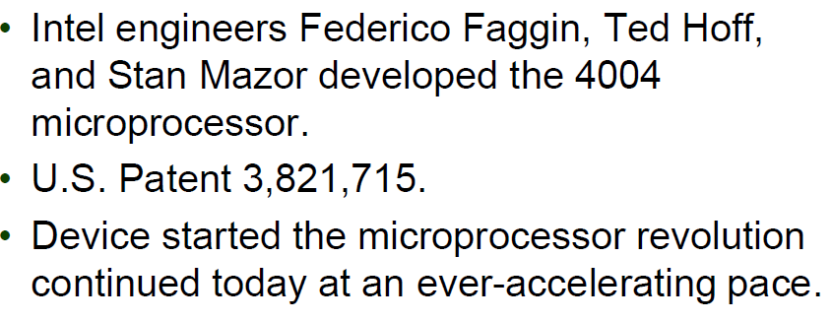
Electronic Age

Slide 24
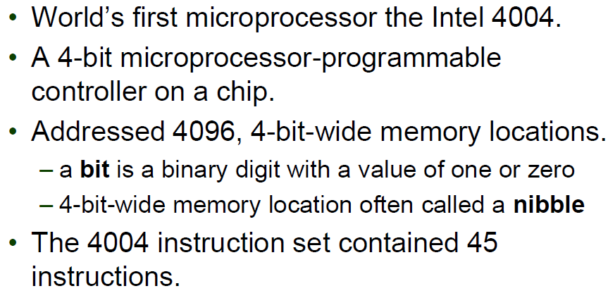
Microprocessor Age- 4004

Slide 25
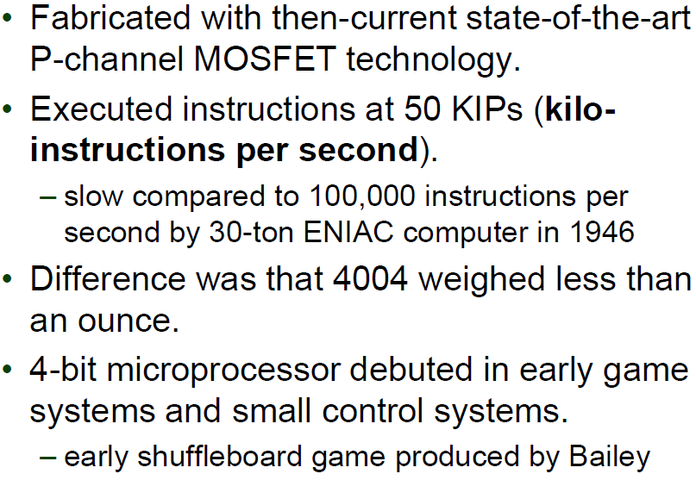
Microprocessor Age-4004

Slide 26
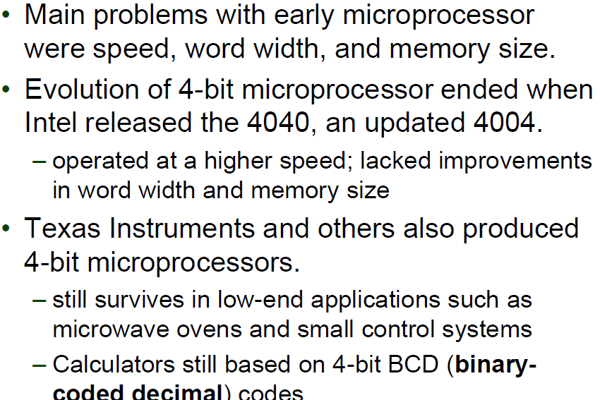
Microprocessor Age-4004

Slide 27
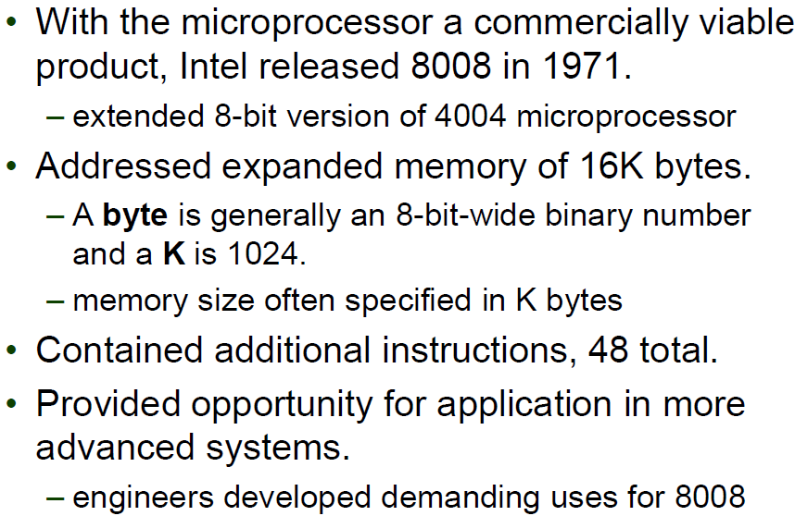
Microprocessor Age- 8008

Slide 28
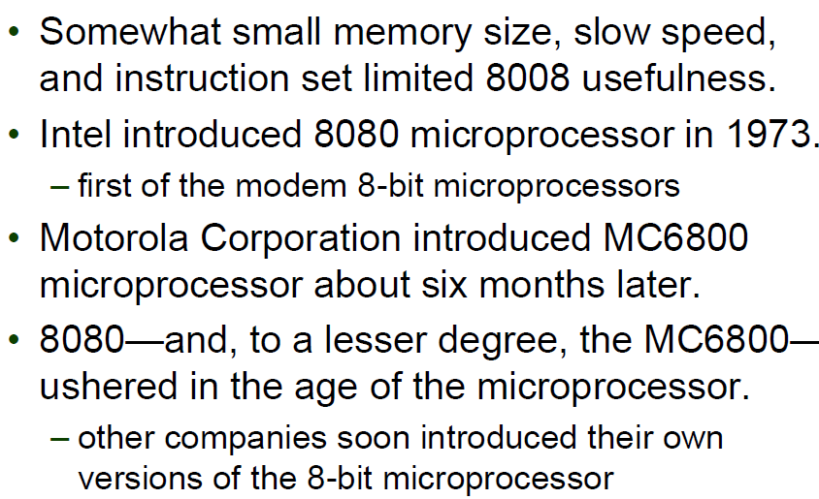
Microprocessor Age-8008

Slide 29
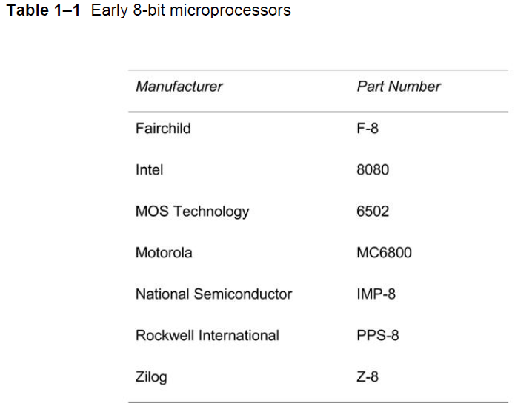
Microprocessor Age-8080

Slide 30
Microprocessor Age-8080

Slide 31
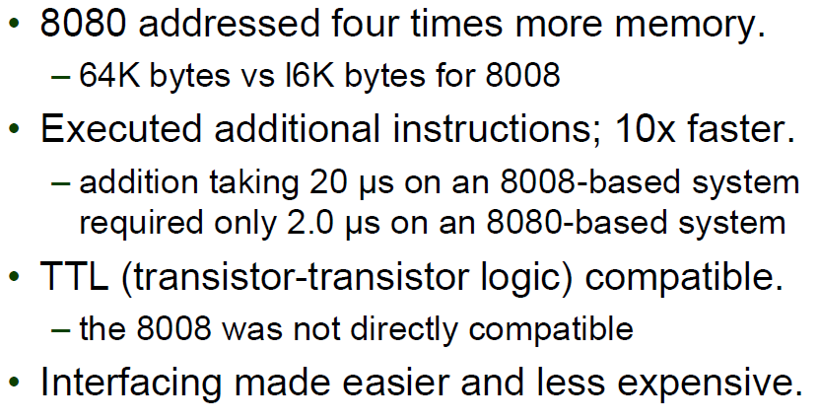
Microprocessor Age - 8080

Slide 32
Microprocessor Age - 8080

Slide 33
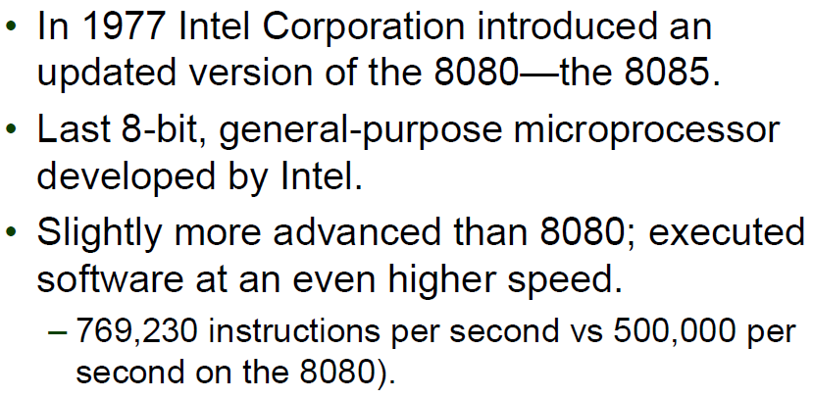
Microprocessor Age - 8085

Slide 34
Microprocessor Age - 8085

Slide 35
Microprocessor Age - 8085

Slide 36
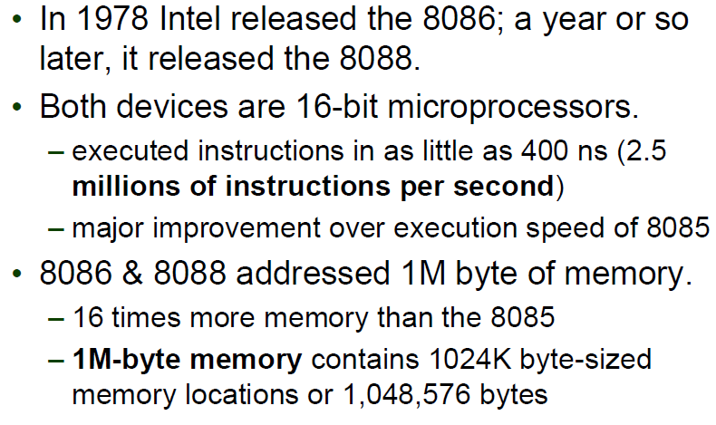
Modern Microprocessor Age - 8086

Slide 37
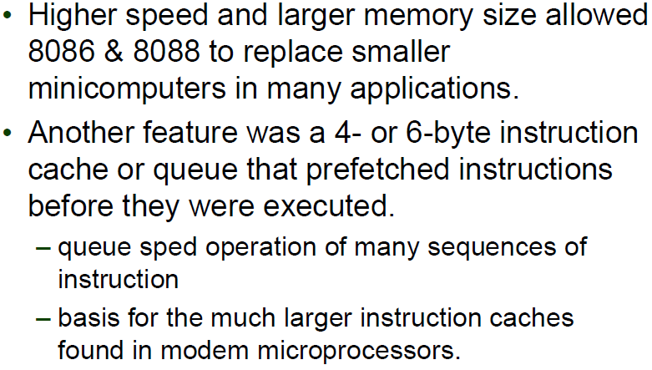
Modern Microprocessor Age - 8086

Slide 38
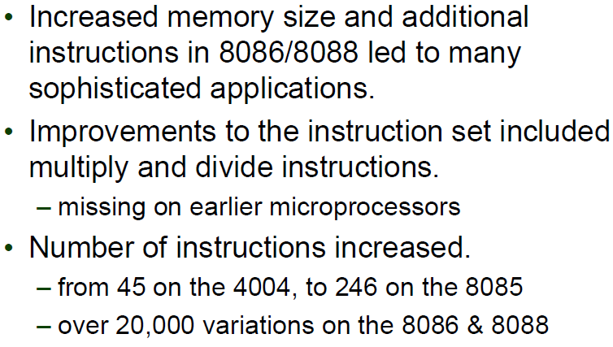
Modern Microprocessor Age - 8086

Slide 39
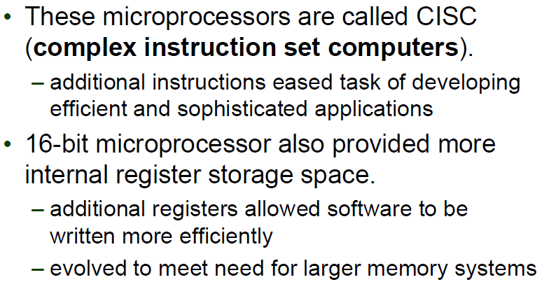
Modern Microprocessor Age - 8086

Slide 40
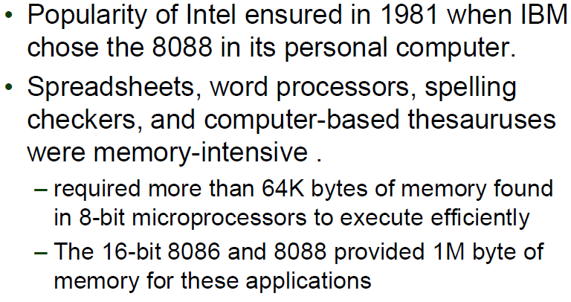
Modern Microprocessor Age - 8086

Slide 41
Microprocessor Age - 80286

Slide 42
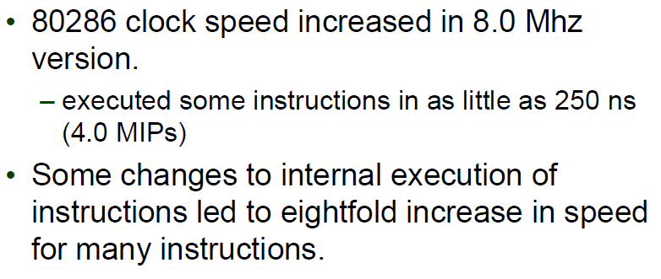
Microprocessor Age - 80286

Slide 43
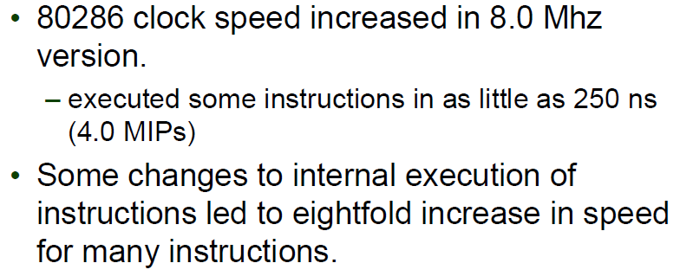
Microprocessor Age - 80286

Slide 44
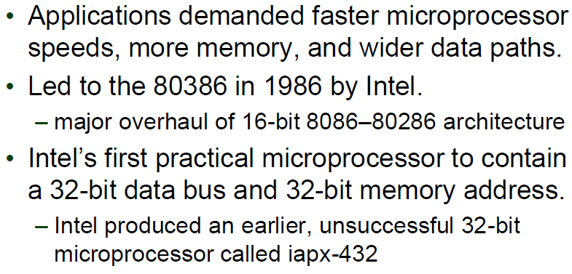
Microprocessor Age - 80386

Slide 45
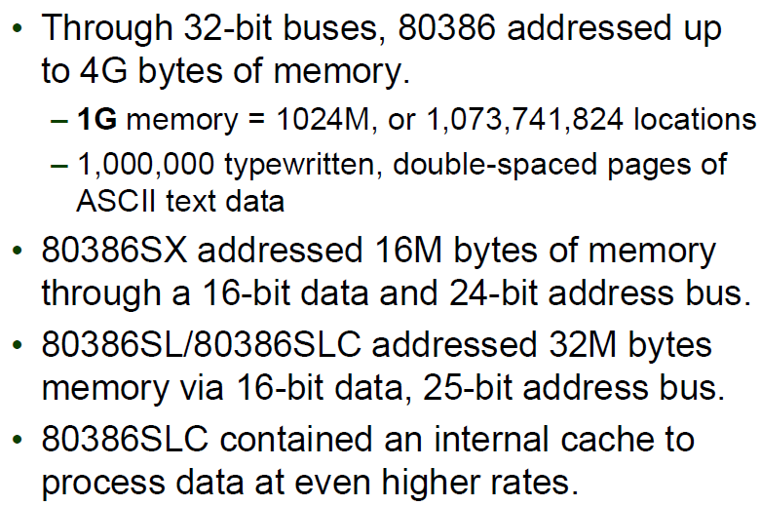
Microprocessor Age - 80386

Slide 46
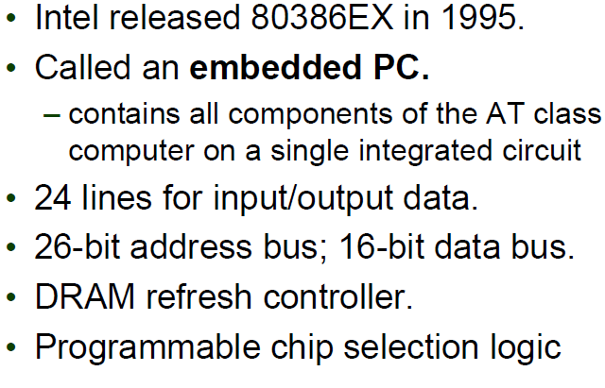
Microprocessor Age - 80386

Slide 47
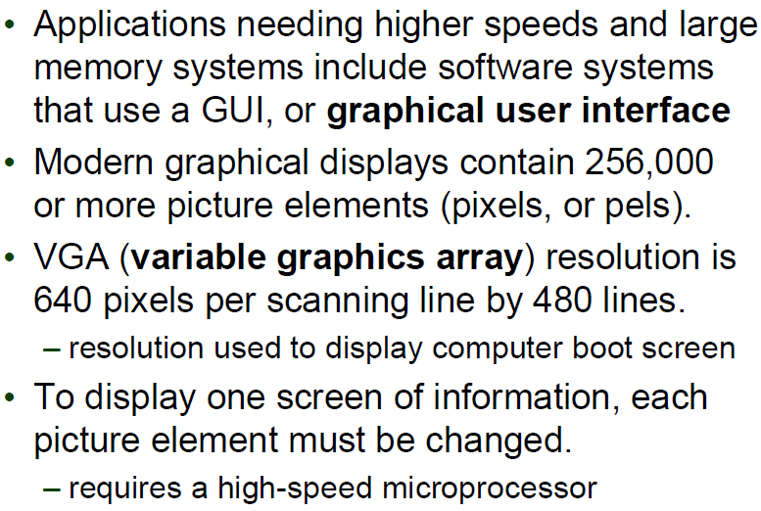
Microprocessor Age - 80386

Slide 48
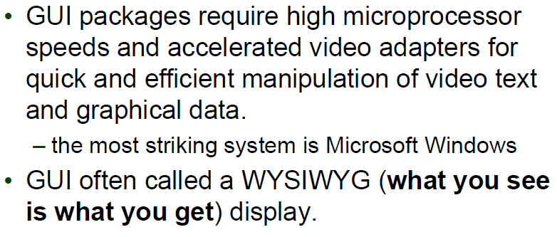
Microprocessor Age - 80386

Slide 49
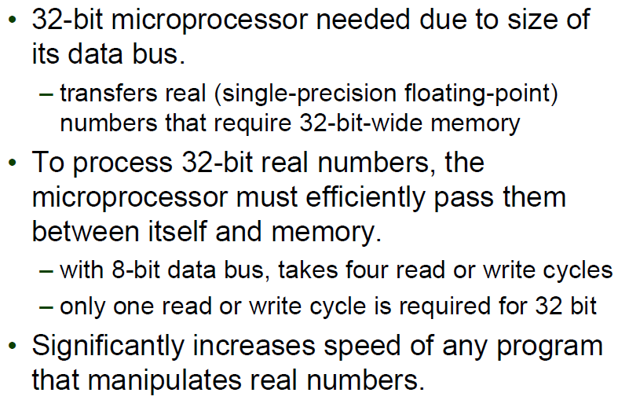
Microprocessor Age - 80386

Slide 50
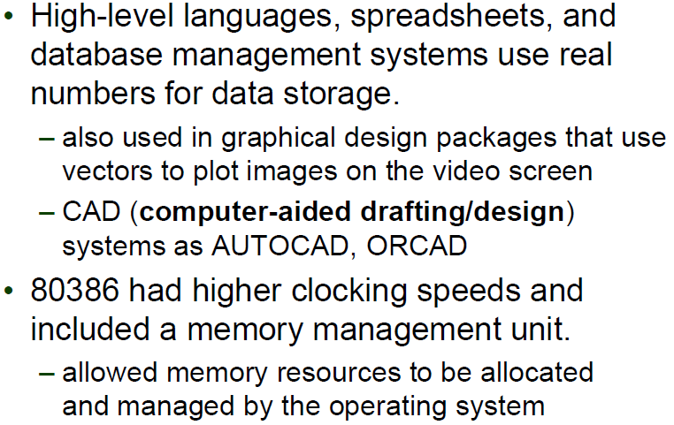
Microprocessor Age - 80386

Slide 51
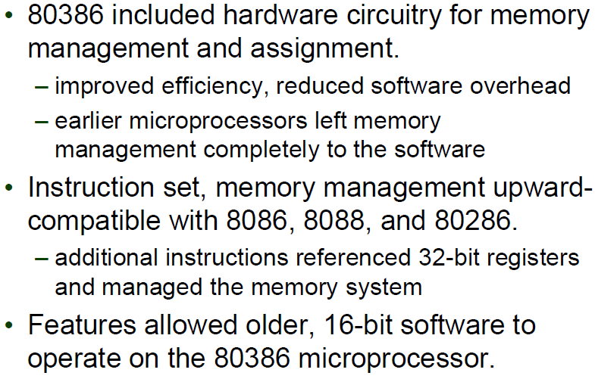
Microprocessor Age - 80386

Slide 52
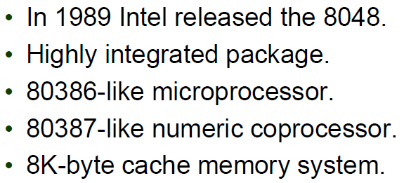
Microprocessor Age - 80486

Slide 53
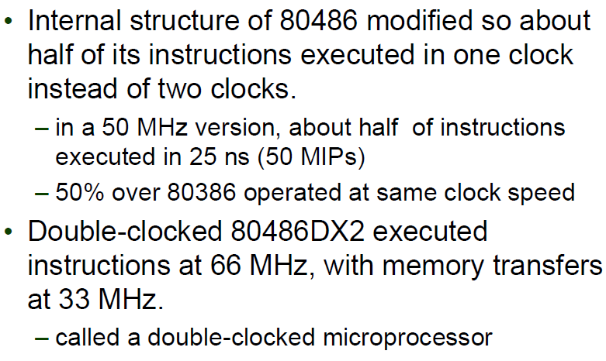
Microprocessor Age - 80486

Slide 54
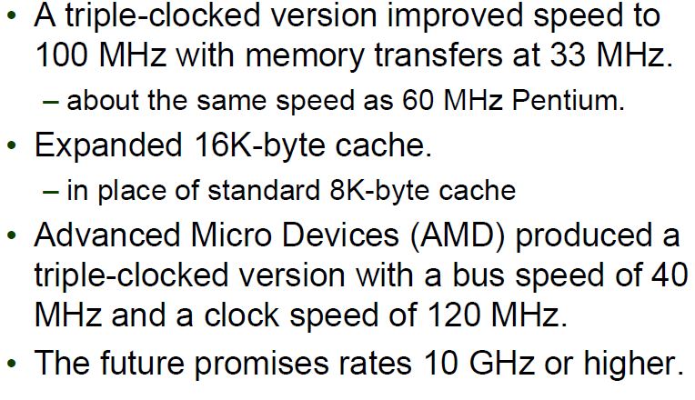
Microprocessor Age - 80486

Slide 55
Microprocessor Age - 80486

Slide 56
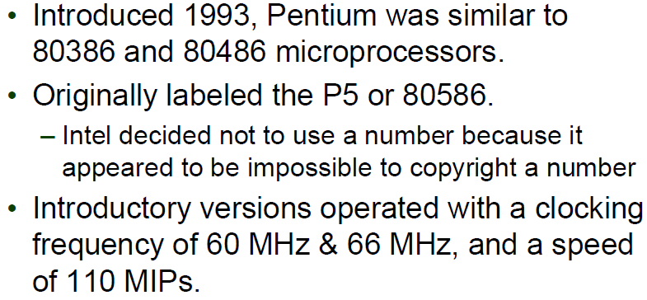
Microprocessor Age - Pentium

Slide 57
Microprocessor Age - Pentium

Slide 58
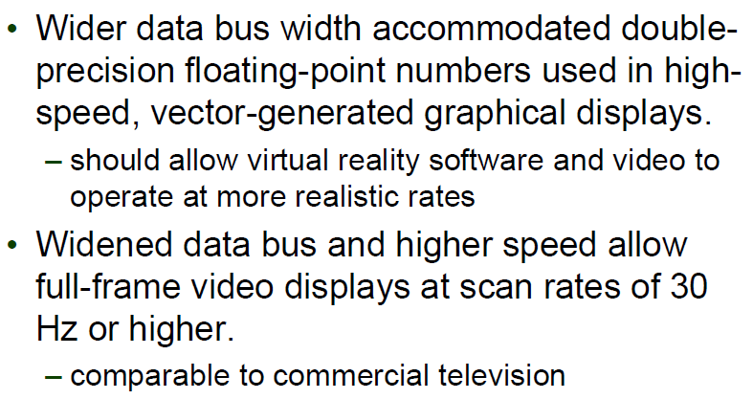
Microprocessor Age - Pentium

Slide 59
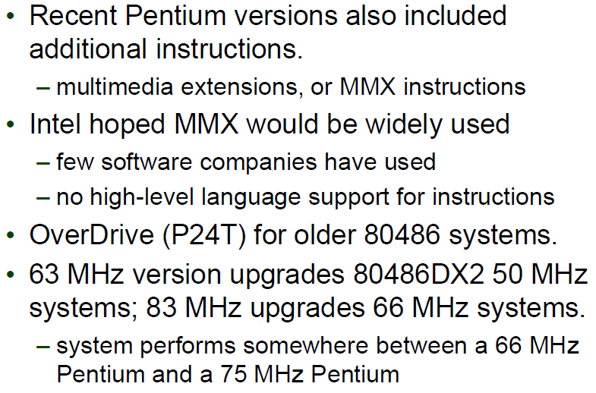
Microprocessor Age - Pentium

Slide 60
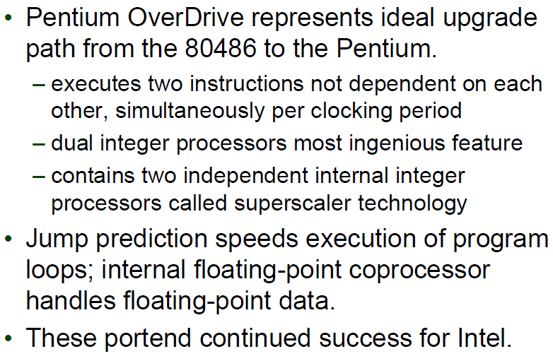
Microprocessor Age - Pentium

Slide 61
Microprocessor Age - Pentium

Slide 62
Microprocessor Age - Pentium

Slide 63
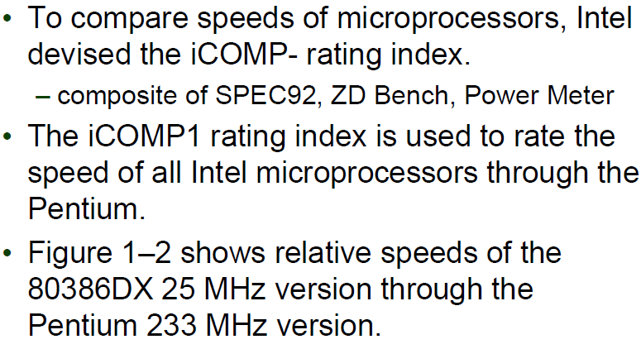
Microprocessor Age – Rating Index

Slide 64
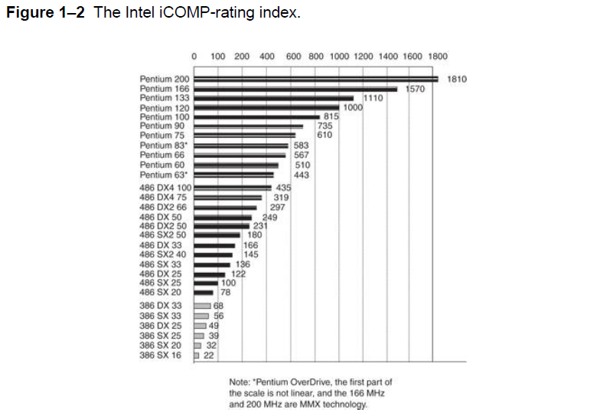
Microprocessor Age – Rating Index

Slide 65
Microprocessor Age – Rating Index

Slide 66
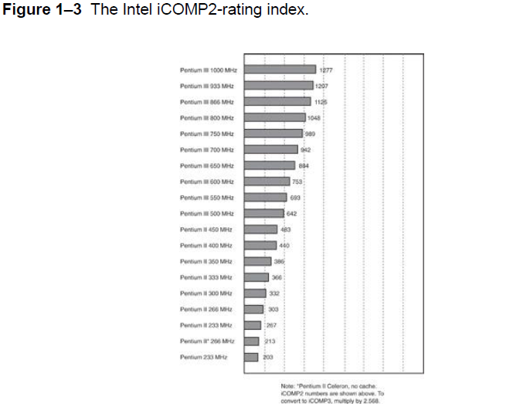
Microprocessor Age – Rating Index

Slide 67
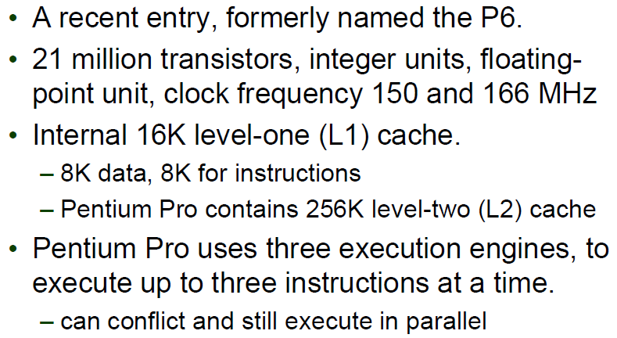
Microprocessor Age – Pentium Pro

Slide 68
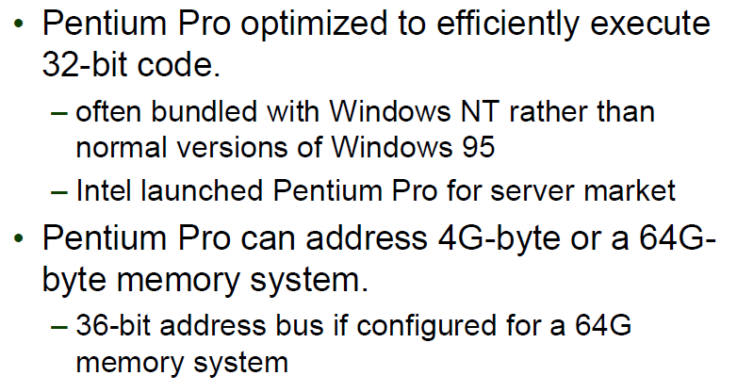
Microprocessor Age – Pentium Pro

Slide 69
Microprocessor Age – Pentium II and Pentium Xeon

Slide 70
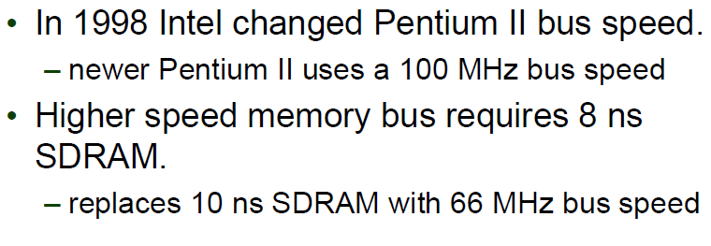
Microprocessor Age – Pentium II and Pentium Xeon

Slide 71
Microprocessor Age – Pentium II and Pentium Xeon

Slide 72
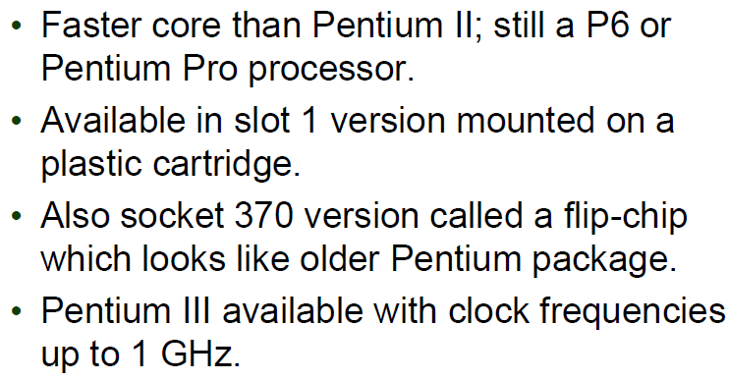
Microprocessor Age – Pentium III

Slide 73
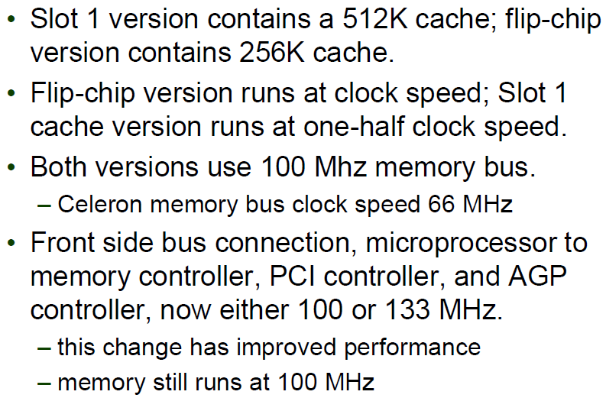
Microprocessor Age – Pentium III

Slide 74
Microprocessor Age – Pentium 4 and Core 2

Slide 75
Microprocessor Age – Pentium 4 and Core 2

Slide 76
Microprocessor Age – Multiple Core microprocessors

Slide 77
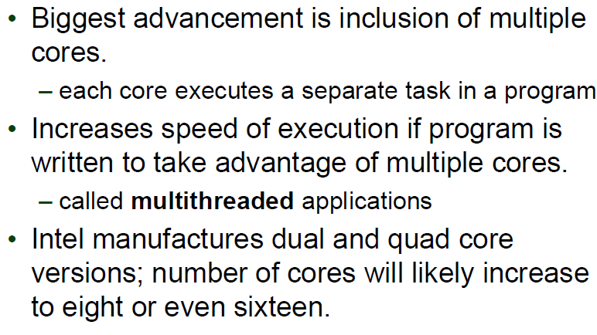
Microprocessor Age – Multiple Core microprocessors

Slide 78
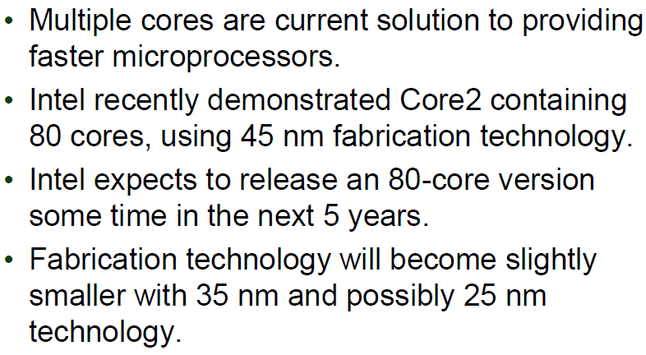
Microprocessor Age – Multiple Core microprocessors

Slide 79
Future of Microprocessors

Slide 80
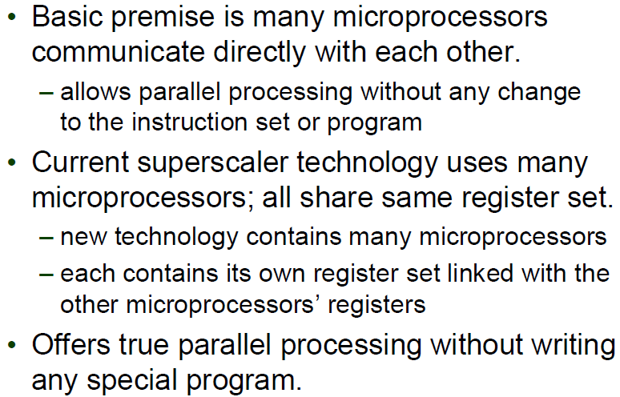
Future of Microprocessors

Slide 81
Future of Microprocessors

Slide 82
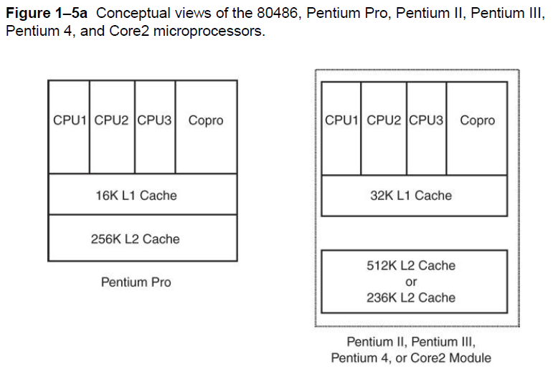
Future of Microprocessors

Slide 83
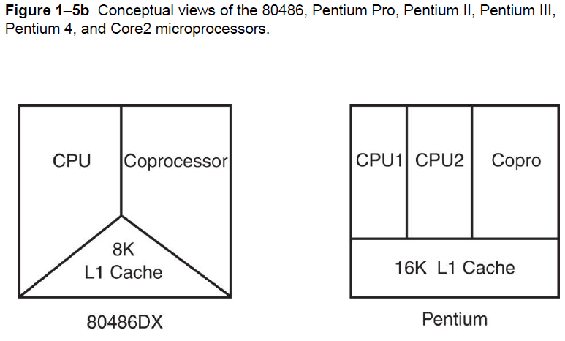
Future of Microprocessors

Slide 84
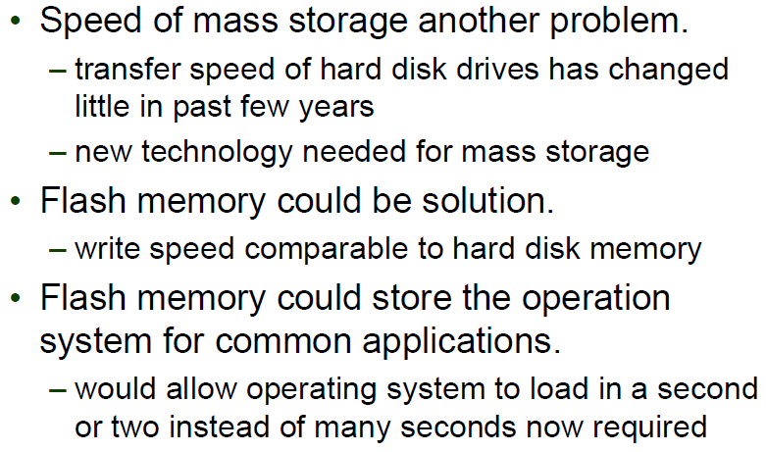
Future of Microprocessors

Slide 85
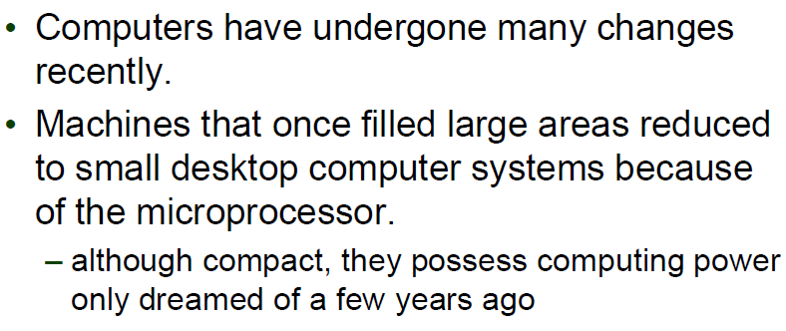
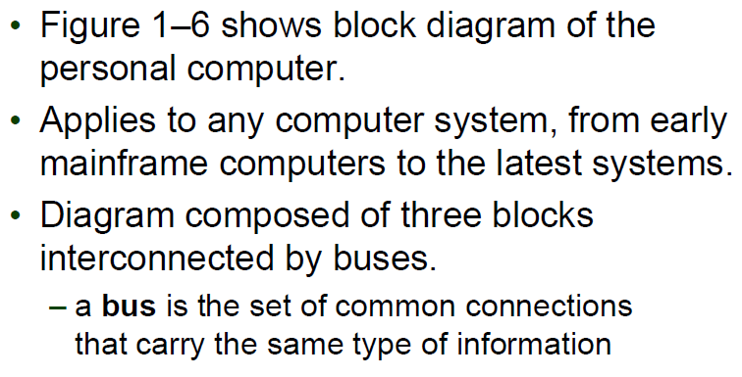
The Microprocessor Based Personal Computer System

Slide 86
Future of Microprocessors

Slide 87
The Memory and I/O System

Slide 88
The Memory and I/O System

Slide 89
The Memory and I/O System

Slide 90
The Memory and I/O System

Slide 91
The Memory and I/O System

Slide 92
The Memory and I/O System

Slide 93
The Memory and I/O System

Slide 94
The Memory and I/O System

Slide 95
The Transit Programmable Area

Slide 96
The Transit Programmable Area

Slide 97
The Transit Programmable Area

Slide 98
The Transit Programmable Area

Slide 99
The Transit Programmable Area

Slide 100
The Transit Programmable Area

Slide 101
The Transit Programmable Area

Slide 102
The System Area

Slide 103
The System Area

Slide 104
The System Area

Slide 105
The System Area

Slide 106
The System Area

Slide 107
Windows Systems

Slide 108
Windows Systems

Slide 109
Windows Systems

Slide 110
I/O Space

Slide 111
I/O Space

Slide 112
I/O Space

Slide 113
Microprocessor

Slide 114
Microprocessor

Slide 115
Microprocessor

Slide 116
Buses

Slide 117
Buses

Slide 118
Buses

Slide 119
Buses

Slide 120
Buses

Slide 121
Buses

Slide 122
Buses

Slide 123
Buses

Slide 124
Buses

Slide 125
References

Slide 126
End of Lecture 1

